Slide 1
Sustainable Development

Slide 2
Why SD?
Communities face enormous challenges as their social, economic, and environmental resources are damaged or depleted.
Because these resources are interconnected, there are no simple solutions to the problems society causes.
There is need to look into economic, social, and political choices that we still can make so that we do not meet even worse ends than many past civilizations.

Slide 3
Meanings of Sustainable Development
1972, United Nations Conference on the Human Environment in Stockholm, Barbara Ward: Only One Earth
1983, the World Commission on Environment and Development was established
1987: Our Common Future
“Sustainable development is development that meets the needs of the present without compromising the ability of future generations to meet their own needs” (WCED, 1987, p.8).

Slide 4
Meanings of Sustainable Development
1992: United Nations Conference on Environment and Development in Rio de Janeiro, the First Earth Summit
Rio Declaration on Environment and Development & Agenda 21
1992: the United Nations Commission on Sustainable Development was established
1996: Habitat Agenda
2000: United Nations Millennium Development Goals
2002: Second Earth Summit in Johannesburg—Johannesburg Declaration & Action 21

Slide 5
MDGs
To eradicate extreme poverty and hunger
To achieve universal primary education
To promote gender equality and empower women
To reduce child mortality
To improve maternal health
To combat HIV/AIDS, malaria, and other diseases
To ensure environmental sustainability
To develop a global partnership for development

Slide 6
Why Sustainable Development (SD) ?

Slide 7
Why SD ?
The world’s population is now at 6 billion, and estimated to grow to 8 billion in the next 20 years.
While most countries’ economies have grown economically in the last 20 years, some have declined.
In the developing world, one in every five persons lives in extreme poverty and many associated social problems result: disease, disintegration of family, crime and use of drugs.
800 million people in the world are still malnourished due to poor distribution in more remote areas.
Diseases such as AIDS and malaria have greatly affected populations

Slide 8
Why SD ?
Since 1971, global energy use has increased by 70% and is expected to rise 2% per year in the next 15 years. This will increase greenhouse gases by 50% over current levels.
The level of carbon dioxide in the atmosphere has increased enormously since 1950, with the global climate changing drastically.
Increased atmospheric nitrogen from fossil fuel combustion and farming of root crops, which release nitrogen, has intensified the occurrence in of acid rain
Natural resources (e.g. soils, forests, fish aquatic habitats) continue to decrease in quantity due to fires, pollution and human influences.
Loss of biological diversity has resulted from human activities such as deforestation and , pollution. 40% of our global economy is dependent on biologically derived products.
Water, soil and air have been strained due to high pollution levels.

Slide 9
Why SD? We are in a Risk Society!
The aging of industrial modernity & the emergence of a risk society
Risk society arises through “the ... modernization processes which are blind & deaf to consequences & dangers.”
“Reflexive modernization”: self-confrontation with the consequences of risk society which cannot be addressed & overcome in the system of industrial society

Slide 10
Meanings of Sustainable Development

Slide 11
Meanings of SD: Nested Sustainable Development
ENVIRONMENT
Environmental Capital:
Air
Water
Noise
Minerals
Forests,
Land,
Species of
Flora &
Fauna
Soil, etc.
SOCIETY
Human, Social & Cultural Capital
Education
Health
Housing
Social Network
Community Spirit
Social Equity
Arts and Culture
Sports & recreation
Entertainment & media,
etc.
ECONOMY
Economic Capital
Built environment
Machinery
Vehicles
Investment, etc.

Slide 12
Meanings of Sustainable Development
Basic Principles:
an ethical utilization of natural resources
Derived Sustainable Development Principles

Slide 13
Meanings of SD: principles & policies
Urban Context
Economic Capital
Economy
Urban fiscal base
Economic spaces
Infrastructure
Built environment
Human and Social Capital
Education
Health
Sports and Leisure
Safety
Community
Political System
Governance
Environmental (Physical & Built) Capital
Food
Air
Water
Noise
Architecture
Cultural Heritage
Sustain. Development Principles
Basic Principles
Ethical utilization of natural resources
Intra- and inter-generational equity
Economic Capital
Long-term economic prosperity
Restorative economy
Reforming market economy
Ecological modernization
Human and Social Capital
Diversities in human resources
Satisfying basic needs
Equity in governance
Social cohesion
Equal opportunities
Environmental (Physical & Built) Capital
Geographical equity
Living within nature’s carrying capacity
Enhancing biodiversity
Replace/ Recycle/ Reuse
Policy Tools
Government
Long term strategic views & integrated policy making
Law & legislation
Financing mechanisms
Government vis-à-vis Market
Ecological modernization
Green consumerism
Targeted inward investment
Promotion of environmental business
Encourage competition
Information dissemination
Government vis-à-vis Community
A learning culture
Three-way (government, private sector, community) partnership
Community based initiatives
Social/cultural/attitudinal changes

Slide 14
Characteristics of SD

Slide 15
Characteristics of SD
ECOLOGICALLY ETHICAL UTILIZATION OF NATURAL RESOURCES
Use of resources and pollution within carrying capacity of nature
Biodiversity enhanced
Three “R”s (reduce, reuse, recycle) to minimize wastes and energy consumption
INTRA- AND INTER-GENERATIONAL EQUITY
Demographic stabilization
Reforming market economy: “restorative”, community based economies vibrant
Ecological modernization
Diversities in human resources development
Diversity in the built environment
Diversity in economic activities
Diversity in culture
Meeting basic needs
Strong social cohesion
Equity in governance
Equal opportunities available
Geographical equity: self-reliance

Slide 16
Characteristics of SD
RESPONSES
Strategic long term view with strategic information
Horizontal cross-sectoral approach within the government
Vertical integration (local-regional initiatives)
Politics: new governance (three-way [public-private-community] partnership)
Sustainable planning process: participation & dialogue
Law & legislation on environmental management
Market: green consumerism, ecological modernization
Socio-cultural changes (public awareness)
Green financing

Slide 17
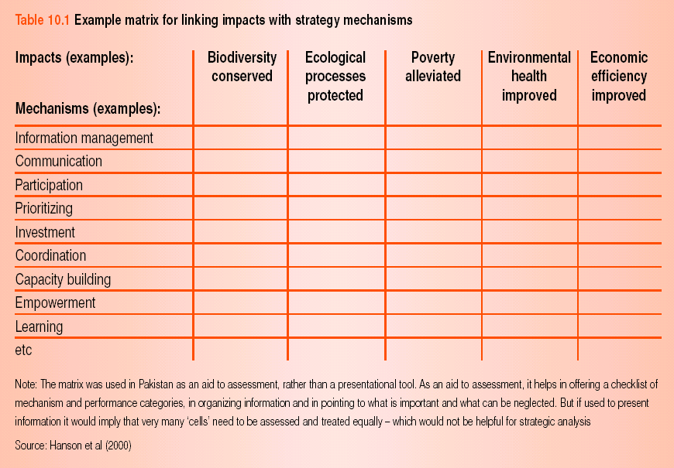
Characteristics of SD

Slide 18
Characteristics of SD
Participation: participatory making good use of local knowledge perspectives of different stakeholders accessible participation channels and information participation should be engagement in making choices and determining future development
Community character: respect community history strengthen community identity facilitate community building and fulfill the needs and expectations of the community
Equity: ensure equitable distribution of benefits and costs consider the impacts on different social groups ensure adequate resources and services are available to mitigate the impacts on disadvantaged groups
Environment: improve the overall living and working environment in order to promote health, safety and enjoyment safeguard resources and prevent environmental degradation
Economy: should improve the overall economic conditions

Slide 19
Why Citizen Participation?
Plans have a greater chance of being implemented when citizens play a meaningful role in shaping them.
They know better what they want!
Stakeholders must feel ownership of the plan.
Identifying common values in divergent interests
Building consensus

Slide 20
Arnstein’s Ladder of Citizen Participation
DEGREE OF CITIIZEN PARTICIPATION
8. Citizen control
7. Delegated power
6. Partnership
DEGREES OF TOKENISM
5. Placation
4. Consultation
3. Informing
NON-PARTICIPATION
2. Therapy
1. Manipulation

Slide 21
Techniques
Citizen attitude surveys
Use of mediator or facilitator
Citizen training
Telephone hotlines
Interactive cable TV
Open door policy
Visioning sessions
Task forces
Public hearings
Guided tours
Workshops/ charettes
Visual preference testing
Game simulation
Citizen advisory board
Media & public information campaigns
Community planning centres
Involving youths & kids

